Slide 1
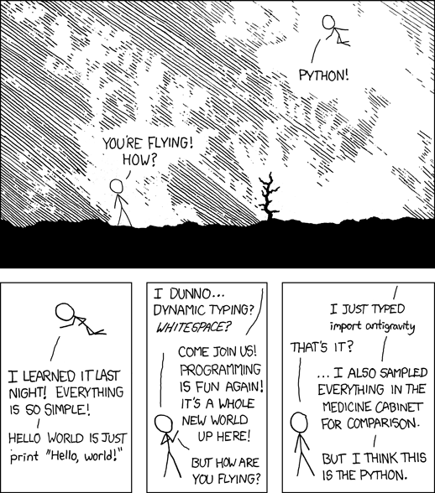
1.1: Introduction to Python
ICS 3U/3C
David Beilby
Zeyad Nasr
Thomas Brittain

Slide 2

Some Background Info
Python was created by Guido Van Rossum and released in 1991.
It is a dynamic, object-oriented programming language.
Python is simplistic and versatile - good for beginners
More advanced uses are mostly found in data science, building neural networks and AI!

Slide 3
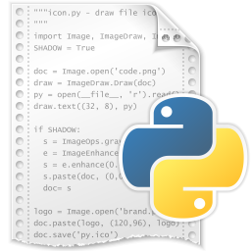
Let’s Code!
IDLE stands for Integrated Developer Learning Environment, it is the code editor (IDE) we will be using for this course.
When we open IDLE, it opens the console, this is where you will see the output when your code runs.

Slide 4
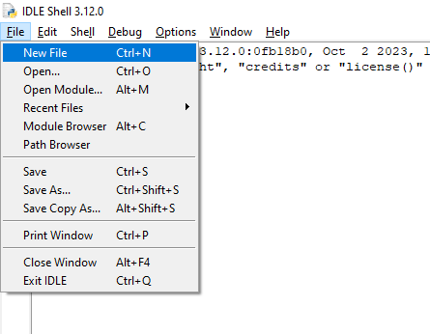
Let’s Code!
In the top left of the console, click file, then select New File.
You can open existing .py files from your computer using the open command as well.

Slide 5
Hello World!
In this new file, you’ll be able to write your code.
Try:
print(“Hello World!”)
Press F5 to run it!
Note: IDLE will prompt you to save the file. Click OK and save it in an accessible folder.

Slide 6
Challenge!
Print the digits from 1 to 5 with each digit appearing on a new line.

Slide 7
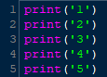
Challenge!

Slide 8
Special Text
There are a few characters that do special functions in a print function.
\n starts a new line. this is automatically put at the end of every print.
\\ prints a single backslash
\” prints a quotation mark.

Slide 9
Special Text
Let's try it out!
Print the digits from 1 to 10 with each digit on a new line.

Slide 10
Special Text
Print the digits from 1 to 10 with each digit on a new line:

Slide 11
Special Text
Try another challenge
Print the following phrase:
“Bolts\Nuts”

Slide 12
Special Text
The second method uses two different quoting methods (“ and ‘) which is why there is no error in the code.

Slide 13
Introducing Variables
A string is a commonly used variable type. It is a series of characters enclosed in quotes.
Introducing strings is easy:
name=“Ms. Rosebery”
Then we can print this name:
print(name)
Note: We don’t use quotes when using a variable in the print function.

Slide 14
The print() function: An in-depth explanation
Print() is a prebuilt function that outputs specified data.
It takes 5 arguments (inputs):
print(*args, sep=‘ ’, end=‘\n’, file=None, flush=False)
*args represents the objects being printed, this could be any data type. For this lesson, we’re only looking at strings.
*args can be multiple pieces of data formatted in mainly 2 ways:
print(“hello”, name) → hello Thomas
print(“hi”+name)→ hiThomas

Slide 15
The print() function: An in-depth explanation
Print() is a prebuilt function that outputs specified data.
It takes 5 arguments (inputs):
print(*args, sep=‘ ’, end=‘\n’, file=None, flush=False)
The sep=‘’ parameter determines the character put between multiple arguments for the *args argument. It is defaulted to a space.
For example: print(“Apples”, “Bananas”) would output with a space in between, but (“Apples”, “Bananas”, sep=‘+’) would output with a + in between.

Slide 16
The print() function: An in-depth explanation
Print() is a prebuilt function that outputs specified data.
It takes 5 arguments (inputs):
print(*args, sep=‘ ’, end=‘\n’, file=None, flush=False)
The end=‘’ argument can add characters to the end of a print function. It is defaulted to \n, which is why the print function automatically goes to a new line.
If we try print(“hello”, end=‘’), we define the end to be nothing, so the next print function will output on the same line.

Slide 17
The print() function: An in-depth explanation
Print() is a prebuilt function that outputs specified data.
It takes 5 arguments (inputs):
print(*args, sep=‘ ’, end=‘\n’, file=None, flush=False)
The file and flush arguments are a bit less useful to us right now.
File can be used to output to a specific file, it is defaulted to output into the python console.
Flush is used to clear the memory cache, which can be useful in very high-level coding, but we don’t have to worry about it in this course.

Slide 18
The input() function
Code functions on an input-process-output cycle.
The input function allows the user to input data to be processed.
var=input(‘prompt’)
Try it!

Slide 19
Commenting
Part of being a programmer, is making code logical and accessible to other people.
Commented lines are denoted by a hash and are not run in the code.
For this course, use comments to describe major components of your code, and why you are using them.

Slide 20

Commenting
For example:
Will only output Hello World once.

